Slide 1
Running CryoSPARC on BioHPC
[web] portal.biohpc.swmed.edu [email] biohpc-help@utsouthwestern.edu
11-17-2021

Slide 2
CryoSPARC on BioHPC
What is new?
Review of access data storage and GPU supports of BioHPC
Setting up user env before running cryoSPARC on BioHPC
Running cryoSPARC on BioHPC with OnDemand service
Some common errors and the way to debug
Case examples

Slide 3
What is new
We have latest version of CryoSPARC (v3.2.0) installation:
With new cuda version (11.3.0)
MotionCorrection 1.4.4
Portal interface for the new version is coming soon…

Slide 4
Access data storage on BioHPC
Guides about BioHPC storage:
1, BioHPC portal Guides/FAQ pages: BioHPC Guides (swmed.edu)
2, BioHPC training slides: BioHPC Storage Overview (swmed.edu)

Slide 5
GPU nodes
GPU Partition | Number of CPU/Node | Memory Per Node | Number of GPU/Node | GPU Memory | Number of nodes
GPU | 32 | 256GB | 1 K20/K40 | 6GB/12GB | 8
GPUp4 | 72 | 384GB | 1 P4 | 8GB | 16
GPUp40 | 72 | 384GB | 1 P40 | 24GB | 16
GPUp100 | 56 | 256GB | 2 P100 | 16GB | 12
GPUv100s | 72 | 384GB | 1 V100S | 32GB | 32
GPU4v100 | 72 | 384GB | 4 V100S | 32GB | 12
GPUA100 | 72 | 1.5TB | 1 A100 | 40GB | 16
Check node availability

Slide 6
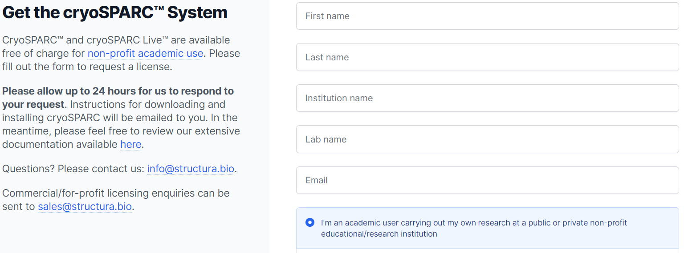
Get the cryoSPARC license
CryoSPARC™ and cryoSPARC Live™ are available free of charge for non-profit academic use. To obtain a License ID for cryoSPARC, go to cryosparc.com/download, fill out the form and submit it.

Slide 7
Export cryoSPARC license ID to user env
Step 1: Create a hidden file (.cryopwd) at user home2 directory, which is used to save the passwd for the cryoSPARC session. Note: Please use some random characters. DO NOT use important password of yours (eg, BioHPC account password)
[s179389@Nucleus006 ~]$ cat ~/.cryopwd
*********
Step 2: Add line “export CRYOSPARC_LICENSE_ID="????????-????-????-????-????????????” to export your cryoSPARC license ID to user .bashrc file.
[s179389@Nucleus006 ~]$ cat ~/.bashrc
# .bashrc
# Source global definitions
if [ -f /etc/bashrc ]; then
. /etc/bashrc
fi
# User specific aliases and functions
module load slurm shared
export CRYOSPARC_LICENSE_ID="????????-????-????-????-????????????"

Slide 8
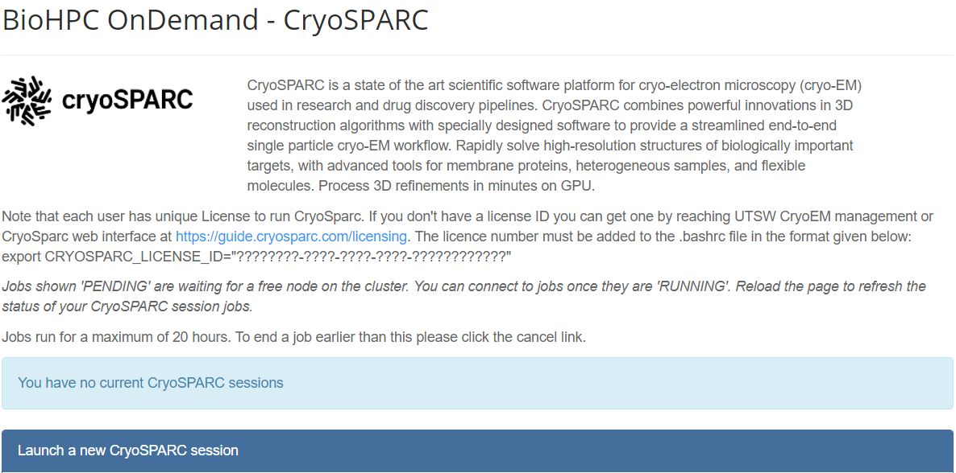
OnDemand cryoSPARC and cryoSPARC Live
Guides about cryoSPARC usage:
1, BioHPC portal Guides page: CryoEM resource on BioHPC (swmed.edu)

Slide 9
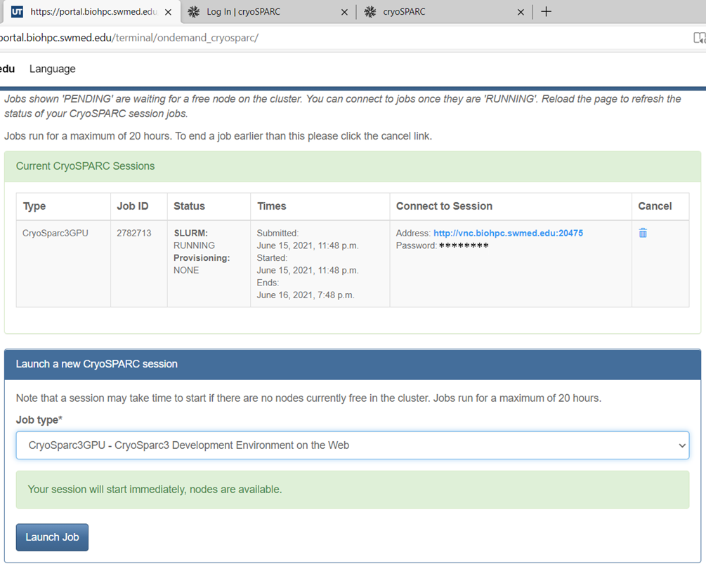
OnDemand cryoSPARC and cryoSPARC Live

Slide 10
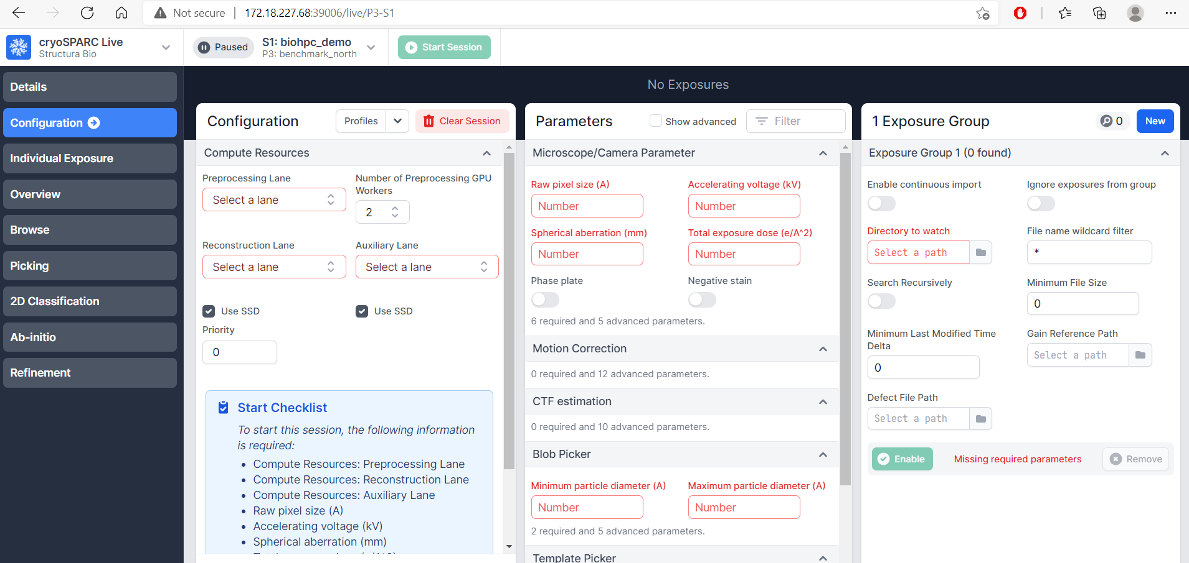
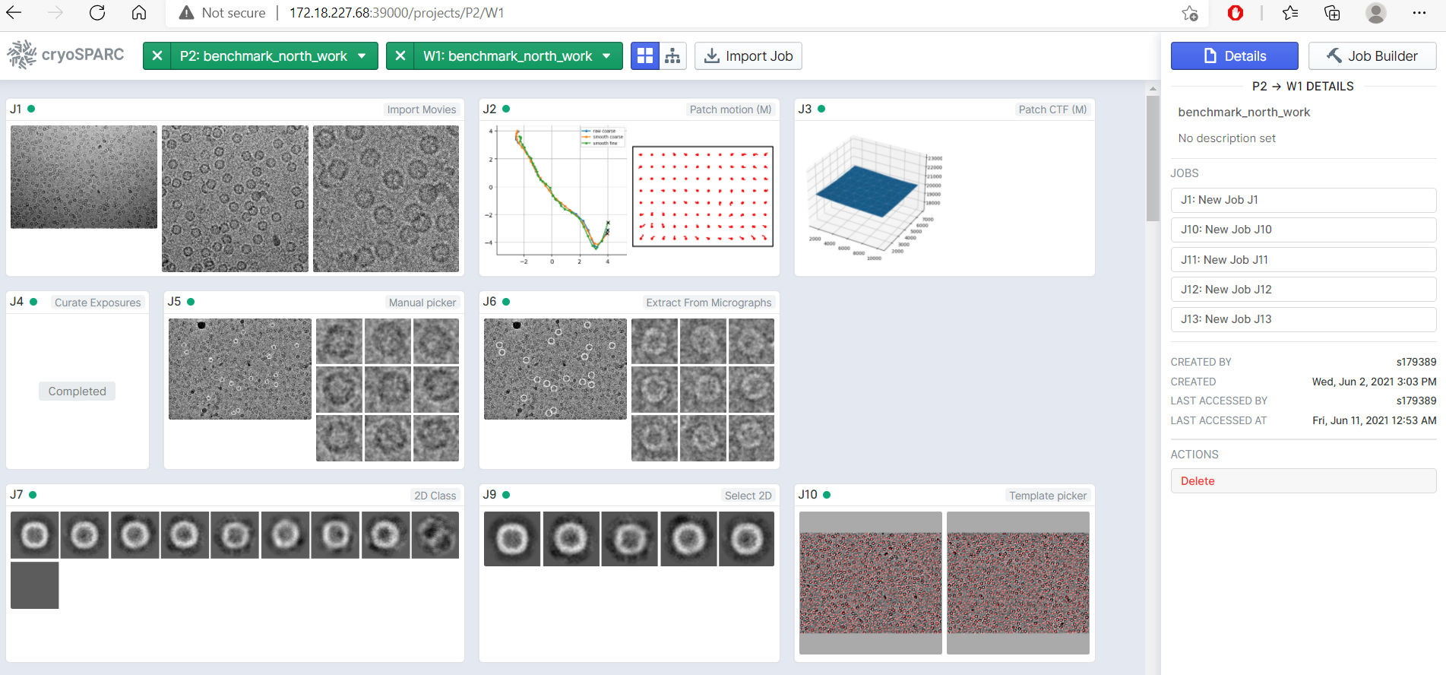
cryoSPARC and cryoSPARC Live

Slide 11
Submit slurm job to start cryoSPARC and cryoSPARC Live
$ cat ~/portal_jobs/cryosparc/cryosparc_sbatch_v100s.sh
#!/bin/bash
#SBATCH --job-name="Cryosparc3"
#SBATCH --partition=GPUv100s # node type
#SBATCH --nodes=1
#SBATCH --gres=gpu:1 # Number of GPUs(per node)
#SBATCH --ntasks=1
#SBATCH --time=2-02:00:00 ## Time limit format: Day-Hour:Minute:Second
#SBATCH --output="logs.cryosprac3.%j.%N.txt"
#SBATCH --error=errors.cryosparc3.%j.%N.txt
module load cryosparc/3.1.0-singularity
export no_proxy="localhost"
export CUDA_VISIBLE_DEVICES=0
cryosparc start
tail -f ~/cryosparc-v3/run/command_core.log
Notes:
The cryoSPARC job usually takes multiple days. Thus, the user may want to run cryoSPARC with SLRUM job.

Slide 12
Submit slurm job to start cryoSPARC and cryoSPARC Live
$ cat ~/portal_jobs/cryosparc/cryosparc_sbatch_v100s.sh
#!/bin/bash
#SBATCH --job-name="Cryosparc3"
#SBATCH --partition=GPU4v100 # node type
#SBATCH --nodes=1
#SBATCH --gres=gpu:4 # Number of GPUs(per node)
#SBATCH --ntasks=1
#SBATCH --time=2-02:00:00 ## Time limit format: Day-Hour:Minute:Second
#SBATCH --output="logs.cryosprac3.%j.%N.txt"
#SBATCH --error=errors.cryosparc3.%j.%N.txt
module load cryosparc/3.1.0-singularity
export no_proxy="localhost"
export CUDA_VISIBLE_DEVICES=0,1,2,3
cryosparc start
tail -f ~/cryosparc-v3/run/command_core.log
Notes:
The cryoSPARC job usually takes multiple days. Thus, the user may want to run cryoSPARC with SLRUM job.

Slide 13
Submit slurm job to start cryoSPARC and cryoSPARC Live
# Submit to start the job
[s179389@Nucleus005 ~]$ sbatch ~/portal_jobs/cryosparc/cryosparc_sbatch_v100s.sh
Submitted batch job 2776433
# Check the cryoSPARC job initialization log
[s179389@Nucleus005 ~]$ cat ~/cryosparc-v3/cryosparc.log
……
From other machines on the network, access cryoSPARC at
http://Nucleus162.cm.cluster:39000
and access cryoSPARC Live at
http://Nucleus162.cm.cluster:39006
……
Success starting cryosparc master!
……
Success starting cryosparc worker
Checking Licence validation !
……
FINISHED : Check ~/cryosparc-v3/run/command_core.log file for detail
Allocated node with cryoSPARC job running.
Connect to cryoSPARC web interface via:
172.18.224.162:39000 (39006: cryoSPARC Live)
The number is from Nucleus162
The other example, if the allocated node is NucleusC048; Connect to cryoSPARC web interface via:
172.18.227.48:39000 (39006: cryoSPARC Live)
The number is from NucleusC048

Slide 14
Submit slurm job to start cryoSPARC and cryoSPARC Live
# Cancel the job after finished
[s179389@Nucleus005 ~]$ module load cryosparc/3.1.0-singularity
[s179389@Nucleus005 ~]$ squeue -u s179389
JOBID PARTITION NAME USER ST TIME NODES NODELIST(REASON)
2776433 GPUp4 Cryospar s179389 R 5:16 1 NucleusC014
[s179389@Nucleus005 ~]$ cryosparc_canceljob 2776433
user confirmed of job: 2776433 running on node: NucleusC014
CryoSPARC is running.
Stopping cryoSPARC
app: stopped
command_core: stopped
command_rtp: stopped
command_vis: stopped
liveapp: stopped
webapp: stopped
database: stopped
Shut down

Slide 15
Disk quota exceeded
[CPU: 1.95 GB] Traceback (most recent call last): File "/app/cryosparc_worker/cryosparc_compute/dataset.py", line 557, in to_file n.save(file, outdata, allow_pickle=False) File "<__array_function__ internals>", line 6, in save File "/app/cryosparc_worker/deps/anaconda/envs/cryosparc_worker_env/lib/python3.7/site-packages/numpy/lib/npyio.py", line 529, in save pickle_kwargs=dict(fix_imports=fix_imports)) File "/app/cryosparc_worker/deps/anaconda/envs/cryosparc_worker_env/lib/python3.7/site-packages/numpy/lib/format.py", line 675, in write_array array.tofile(fp) OSError: [Errno 122] Disk quota exceeded
Action: Clean up BioHPC storage space. Or contact BioHPC for increasing the quota
Notes:
Ticket#2021080510000071 — "Disk Quota exceeded error" in Cryosparc

Slide 16
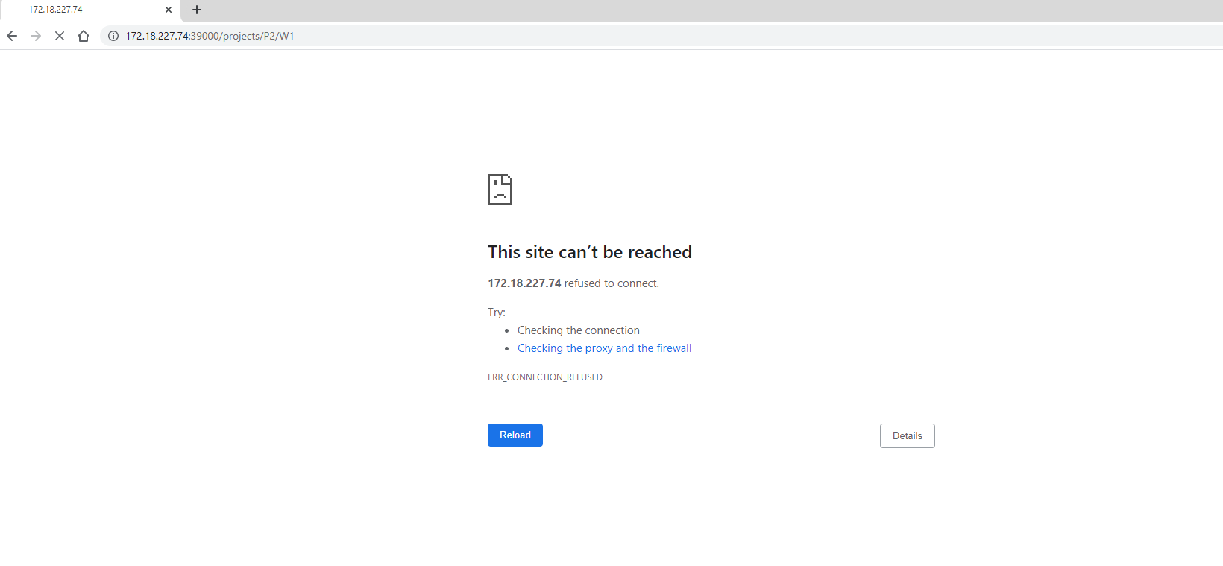
Running two cryoSPARC instances at the same time on BioHPC
Action: Cancel the second cryoSPARC running instance

Slide 17
Can’t connect to the cryoSPARC web interface
# Check the error from the cryoSPARC job initialization log
[s179389@Nucleus005 ~]$ cat ~/cryosparc-v3/cryosparc.log
……
** client.py: command (http://localhost:39002/api) did not reply within timeout of 300 seconds, attempt 1 of 3
*** client.py: command (http://localhost:39002/api) did not reply within timeout of 300 seconds, attempt 2 of 3
*** client.py: command (http://localhost:39002/api) did not reply within timeout of 300 seconds, attempt 3 of 3
……
Action: Cancel the current cryoSPARC running instance and restart new one.

Slide 18
License is invalid
Action: Cancel the current cryoSPARC running instance and restart new one.

Slide 19
Questions? Comments?
Email: biohpc-help@utsouthwestern.edu
Thanks!

